Slide 1
Capstone Project Play Store App Review Analysis
By
Abhinov Anand
Saurov Kumar
Vivek Kumar
Data Science Trainee, AlmaBetter

Slide 2






WHY ANALYZE THE GOOGLE PLAY STORE?
Mobile App Market is set to grow 20% by 2023
Android Apps comprise 90% of the Mobile App Market
What makes an App popular? Can we predict how popular it’s going to be?
What are some interesting patterns in user behavior related to app usage & feedback?

Slide 3
INTRODUCTION
Google Play , formally known as android market, is the official distribution storefront for Android Applications and other digital media such as music, movies and books from google.
The Google Play store launched on march 6th, 2012 consolidating the android market and other digital services, like Google Music and Google eBookstore, into one offering. Currently storefront is available in over 190 countries and territories.
Android is dominant mobile operating system today more than 85% of all mobile devices running Google’s OS. The Google Play Store is largest and most popular Android app store.
There are more than 3.04 million apps found on Google Play Store.
The purpose of our project is to gather and analyze details information on apps in the Google Play Store in order to provide insight on app features and the current state of the Android app market.

Slide 4
PROBLEM STATEMENT
Two data set are provided, one with basic information and the other with user reviews for the respective app.
We must examine and evaluate the data in both datasets in order to identify the important characteristics that influence app engagement and success.
So, what factors influence an app’s success
An app is said to be successful if it has:
A high average user rating
A good number of positive reviews
A good number of monthly average users
High revenue per customer and so on.

Slide 5

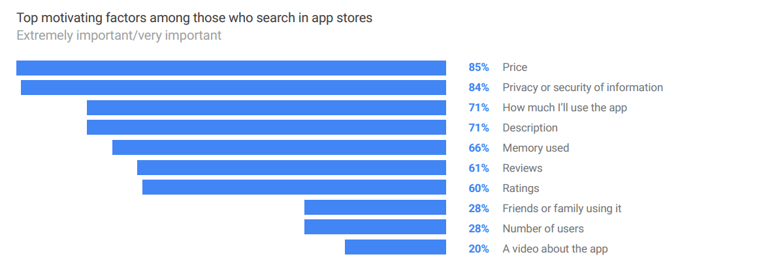
THE MOTIVE:
Import Factors While Installing Apps:
Play Store had widely network its get trouble for users to install the apps from play store.
Following are major roles for user while installing any apps from play store.

Slide 6
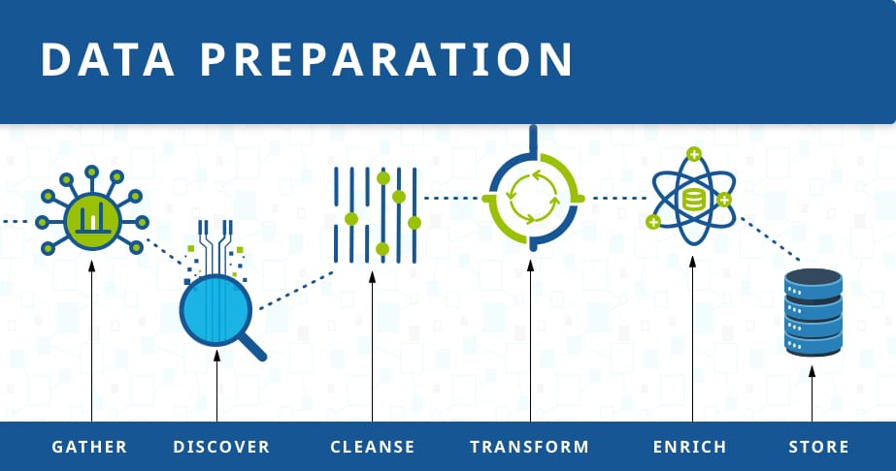
DATASET PREPARATION
Loading the data sets: Two data sets, first Play Store app dataset and user reviews datasets.
Importing libraries: NumPy, Pandas, Seaborn and Matplotlib.
Data cleaning: Null values, Finding and removing outliers, Removing duplicate data.
Data Manipulation: Filling the missing categorical values with mode and numerical values with median. Conversion of price installs, reviews into numerical values.
Exploratory Data Analysis: Analysing the data sets to summarize their main characteristics using statistical graphics and data visualisations method.

Slide 7
ATTRIBUTE IN GOOGLE PLAY STORE DATA
1.Apps:The apps name.
2.Category:Categorical label, which describes which broad category the app belongs to.
3.Rating:Continious variable with a range 0.0 to 5.0, which describe average rating.
4.Reviews:Continious variable describing the number of reviews that the app received.
5.Size:The size of the app. The suffix M is used for megabytes while K used for kilobytes.
6.Install:Categorical label that describes the number of installs.
7.Type:Label that indicates whether the app is free or paid.
8.Price:The price value for the paid apps.
9.Content Rating:Categorical rating that indicates age group for which app is suitable.
10.Genre:Semicolon-separated list of genre to which the app belongs.
11.Last Update:The date of the app was last updated.
12.Current Version:The current version of the app as specified by the developers.
13.Android Version:The Android operating system the app is compatible with.

Slide 8



OVERVIEW OF ANALYSIS
Data Cleaning
Data Exploration
Predictive Modelling
Understand the structure of the dataset and clean data before analysis
Uncover initial patterns, characteristics, and points of interest using visual exploration
Formulate a statistical model to forecast an outcome using relevant predictors

Slide 9
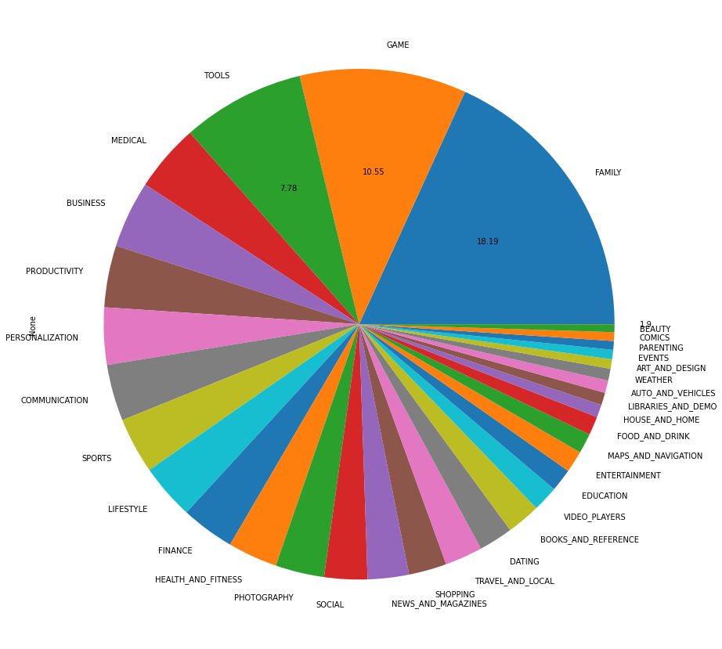
DISTRIBUTION OF CATEGORY
This pie chart shows us the Family related apps are the most number in availability, followed by Games which is generally preferred by Children. This two constitute nearby 30% of the available Apps.

Slide 10
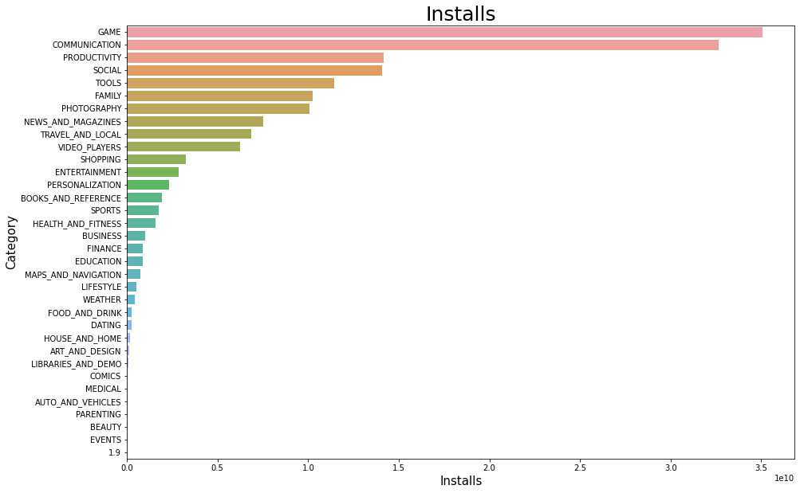
CATEGORY WISE INSTALL
Quiet Shocking! despite having most number of Family related Apps, their installs are very less compared to their availability even not come in top 5 category wise. Game category able to dominate in both in their number of availability and Installs.

Slide 11
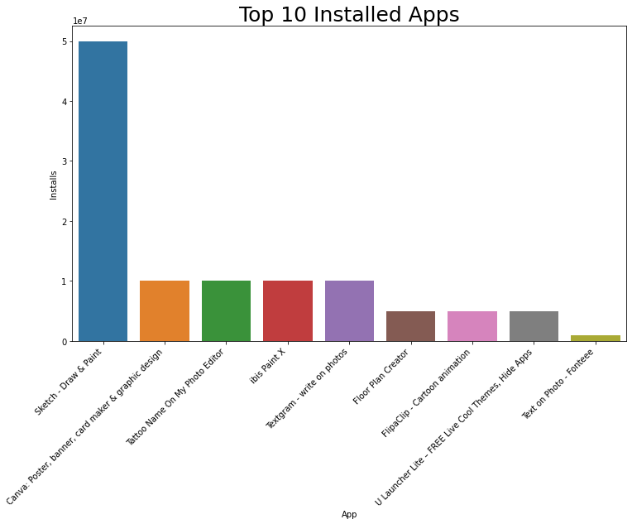
TOP 10 INSTALL APPS IN ANY CATEGORY
If we select a category, for example 'ART AND DESIGN’, here we can see stark difference between to Apps like Sketch-Draw & Paint and other Apps. Reason could be anything like people's intrest, easy to use, price, commercial nature etc.

Slide 12
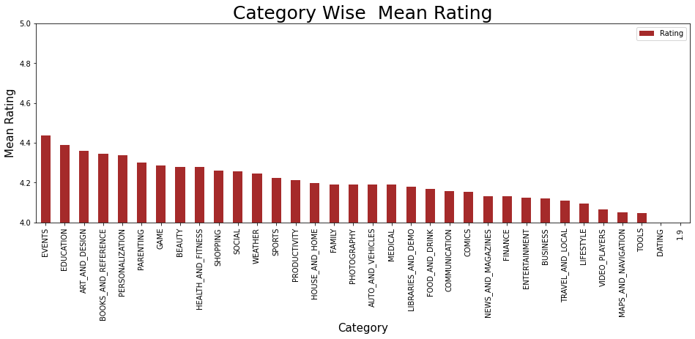
CATEGORY WISE MEAN RATING
This shows the Education related Apps also more desirable for the users, their high rating suggest why the current generation knows going for the online education. Online education provide oportunities to the student especially girls in remote areas to access the learning material.

Slide 13
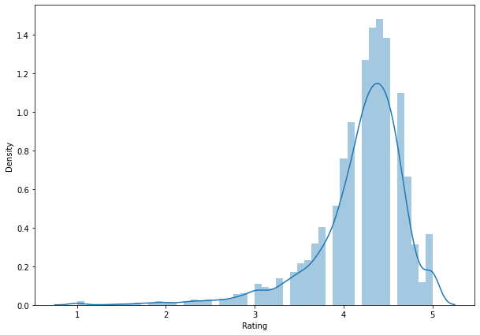
DENSITY OF RATING
The density rating graph shows the user's level of satisfaction using different Apps. By seeing data, we can people are giving on an average more than 4 out of 5 which show that user's are nearly satisfied with the services. This will help to compare the performance of Apps in Google Play store with that on other Play Store.

Slide 14
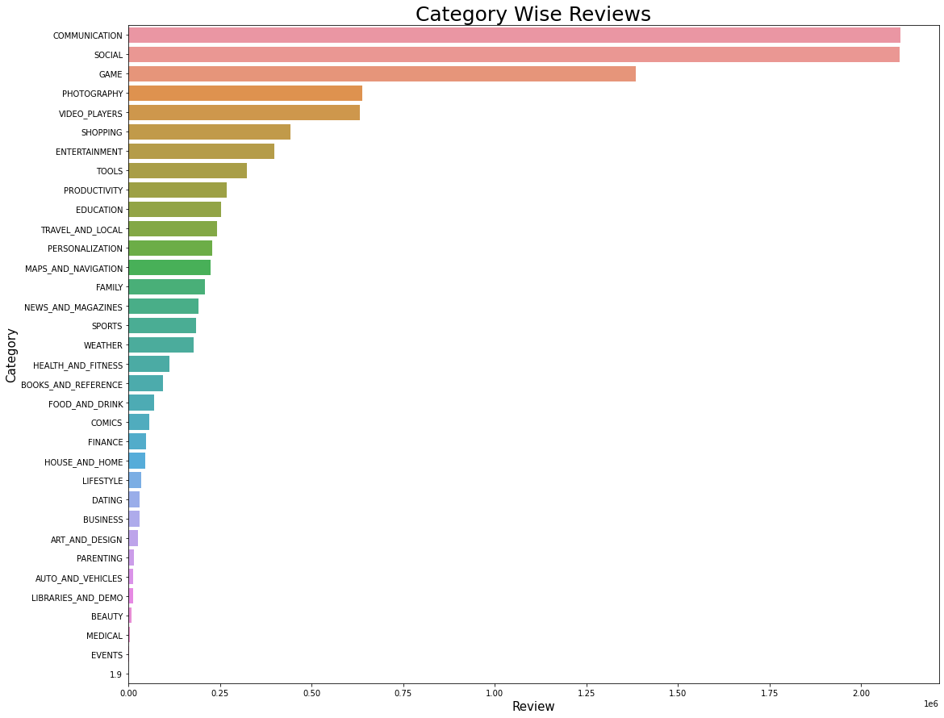
CATEGORY WISE REVIEWS
Higher reviews in categories of Communication and Social related Apps signifies their use and people's interest in knowing about them. Since Communication and Social Apps are some of the important sector where people remain being careful before using because of its effectiveness and privacy.

Slide 15
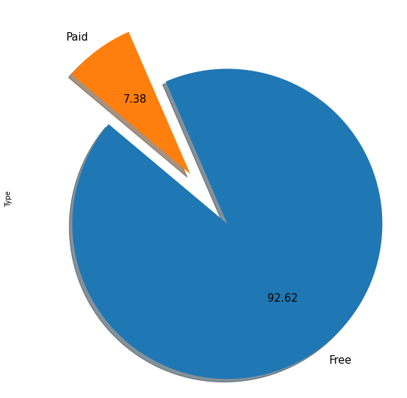

PERCENTAGE OF PAID APPS VS FREE APPS
Wow, Results are quite astonishing! Only 7-8% are paid Apps thus makes Google Play Store most popular among the users. Even middle class or poor can use this store optimally.

Slide 16
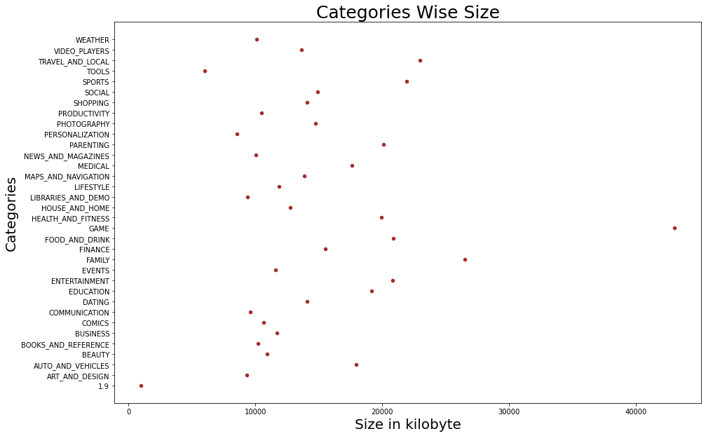
CATEGORY WISE SIZE
Quite surprising! despite having large size, Games related Apps still have one of the highest installs.This could be mainly due to the craze among the children and youth for the games as well as they also attracted toward graphics, visual effect which makes Games attractive with large size.

Slide 17
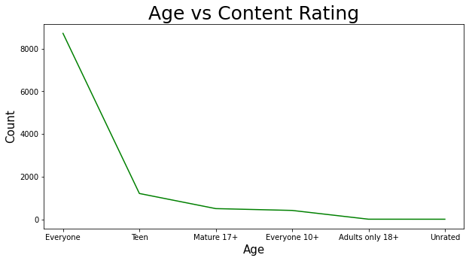
AGE VS CONTENT RATING
As we can see, absolute majority of the developers focuses for everyone means users of all ages. It also can be analysed that content rating has near funneling effect on age. As the number of Apps for a specific age is lesser as user get older. This can be understood, lower user bank would not generate much revenue thus very little developer would be interested in targeting smaller piece of population.

Slide 18
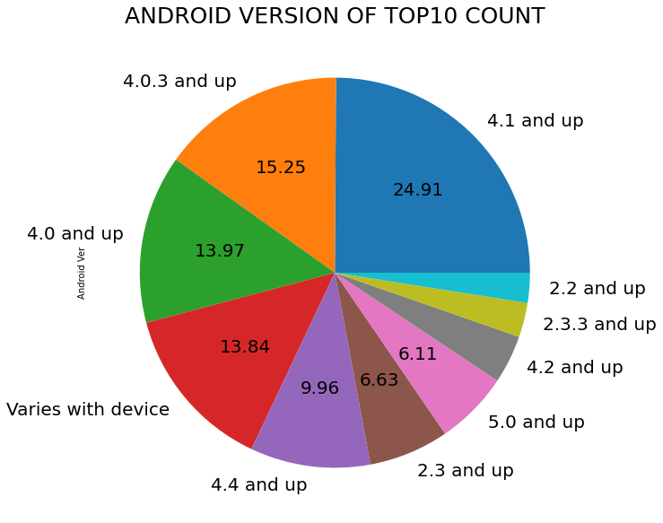
ANDROID VERSION OF TOP 10 COUNT
Here we can see, despite several upgradation version 4.0 and 4.1 dominant in the market, with together they comprise nearly 50% of the total number of Apps.
Point to note that latest update of Android that is Version 8.0 is no where in top 10 which show that people are still unaware of the upgradation or might be later version would not be much userfriendly,thus could not able to attract many users.

Slide 19
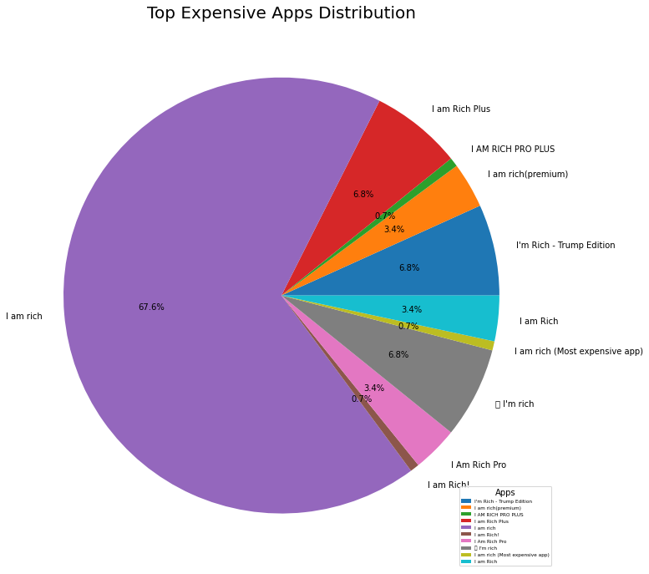
TOP MOST EXPENSIVE APPS
Here we can see, one App nearly dominated the price domain.
I'm Rich developed by Armin Heinrich of lifestyle genre topped the most expensive app of nearly 400$ cost. Its other genre like of finance also very expensive.

Slide 20
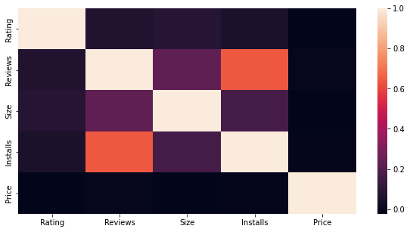
CORRELATION HEATMAP
By analysing heatmap,we can point out that Reviews and Installs are most closely related in a positive way.
Price relation with every feature is near zero because for most of the Apps price are free.
We can also see the little impact of rating of Rating on Installs because of the higher density of the Rating in between 4 to 5 out of 5.

Slide 21

CHALLENGES FACED(continued)
Reading the dataset and comprehending the problem statement.
Examining the business KPIs for app development and devising a solution to the problem.
Handling the error, duplicate and NaN values in the dataset.
Designing multiple visualisations to summarize the information in the dataset and successfully communicate the results and trends to the reader.

Slide 22

CHALLENGES FACED
The data has lot of chunk features everyone not be missing so handle with care to our dataset.
The Data must be clean, a single string can make our total data irrelevant for analysis.
User reviews and play store are of two types data which have to work simultaneously is considering a bit time consuming.

Slide 23
CONCLUSION (continued)
Family and Game related Apps are most available category.
Most installed category of apps is Games and Communication. Family related Apps not comes in even top5.
If we go through the Category of 'Art and Design’, Sketch, Draw & Paint is most installed apps much more than its followed apps.
All category of Apps got more or less same rating in between 4 & 5 and the Events and Education were the top rated Apps.
By analysing Rating Density, we come to know that most number of user given rating between 4 & 5.

Slide 24
CONCLUSION (continued)
Communication and Social category of Apps got most number of reviews. Might be duty to the sensitivity of privacy which user see before using these Apps.
Nearly 93% of Apps are free thus make Android Market more popular store than others.
By looking at Category Wise Size, the most number of Category have average size in between 10MB and 20 MB. Games occupies the maximum amount of space up to 40 MB still have a maximum number of Installs.
Most of the Apps are suitable for Everyone, as we increase the suitable age less and less number of Apps are targeted.

Slide 25

CONCLUSION
Most of the Apps are compatible with Android Version of 4.0 and 4.1.
Version of 8.0 despite being latest, not comes even in top 10 in compatibility with other Apps.
I'm Rich developed by Armin Heinrich of lifestyle genre topped the most expensive app of nearly 400$ cost. Its other genre like of finance also very expensive.
By analysing heatmap, we can point out that Reviews and Installs are most closely related in a positive way.
Price relation with every feature is near zero because for most of the Apps price are free.

Slide 26


